Slide 1
Data Science Final Project
Presented by:
Gila Aweke
Adar Kabada

Slide 2
Data Acquistion
Crawled the movies data using BeautifulSoup.
Filtered the data to be relevant to the movies which produced by year
Carried out by the use of Python libraries.
Stored the data in lists and created the dataframes on the base of the lists.

Slide 3
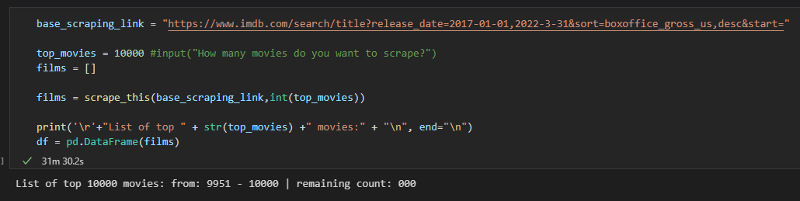
Crawled the IMDB Data and Stored as DataFrame

Slide 4
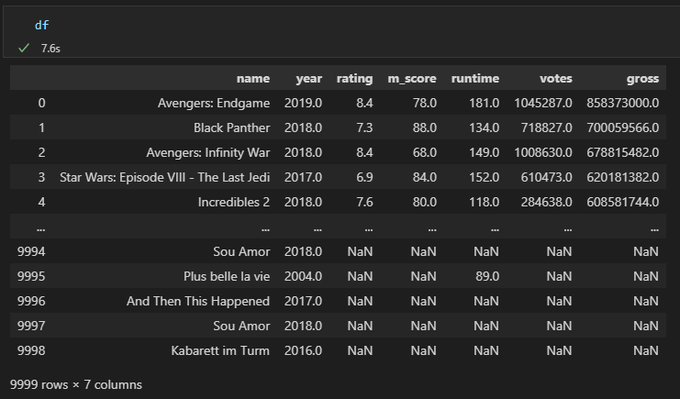

Slide 5
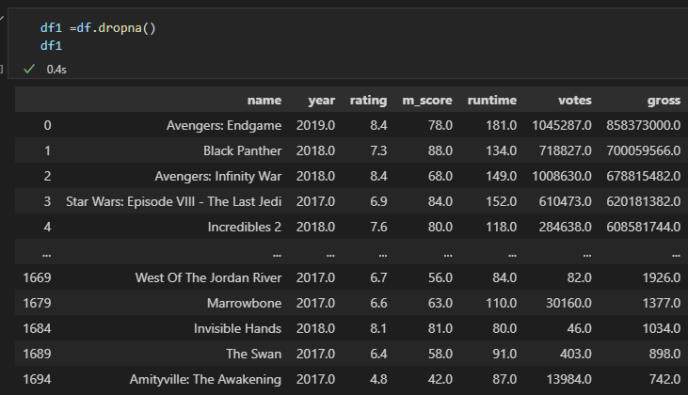
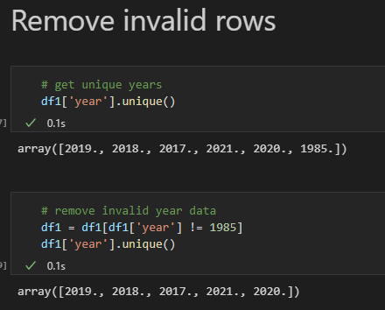
Data Pre-processing
Checked for null values and drop them..

Slide 6
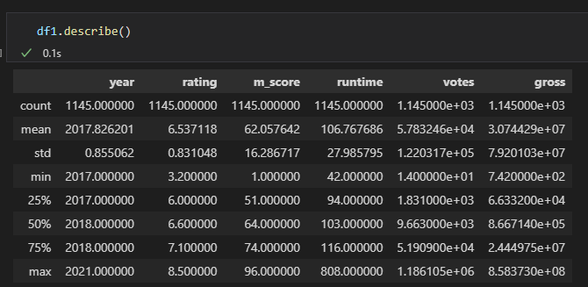
Exploratory data analysis

Slide 7
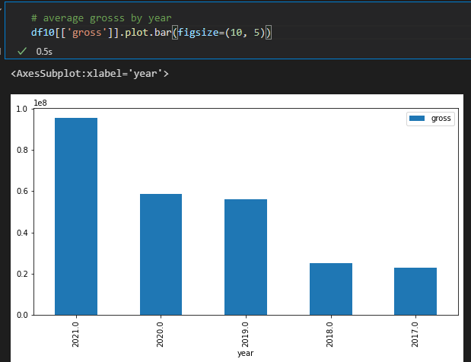
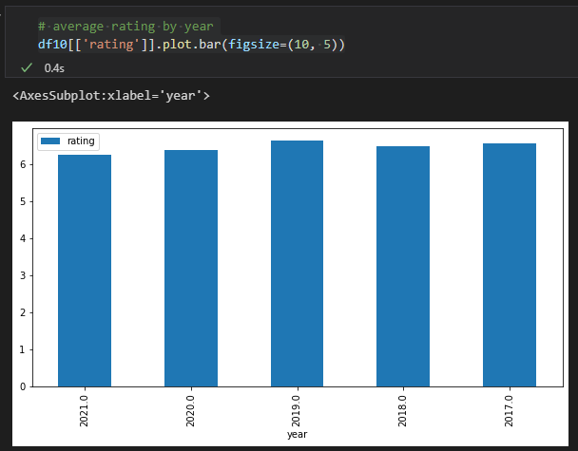
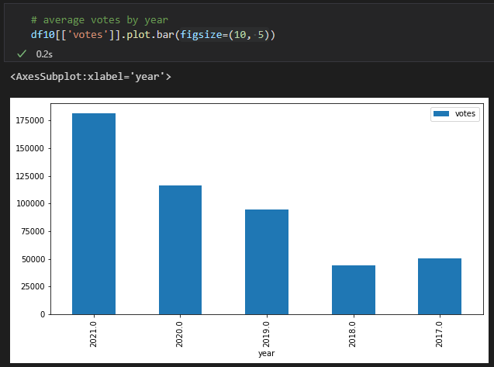
Average gross, rating, votes per year analysis

Slide 8
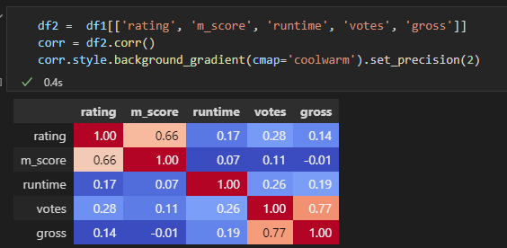
Correlation Analysis

Slide 9
ML Model (Regression Models)
Research questions
Can we predict movie`s gross based on other features(rating,m_score,runtime,votes) using historical data?

Slide 10
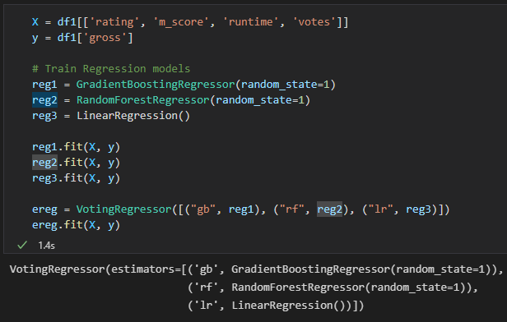
Create Regression Model
In this project, we implement four regression models:
Gradient Boost Regressor
Random Forest Regressor
Linear Regressor
Voting Regressor

Slide 11
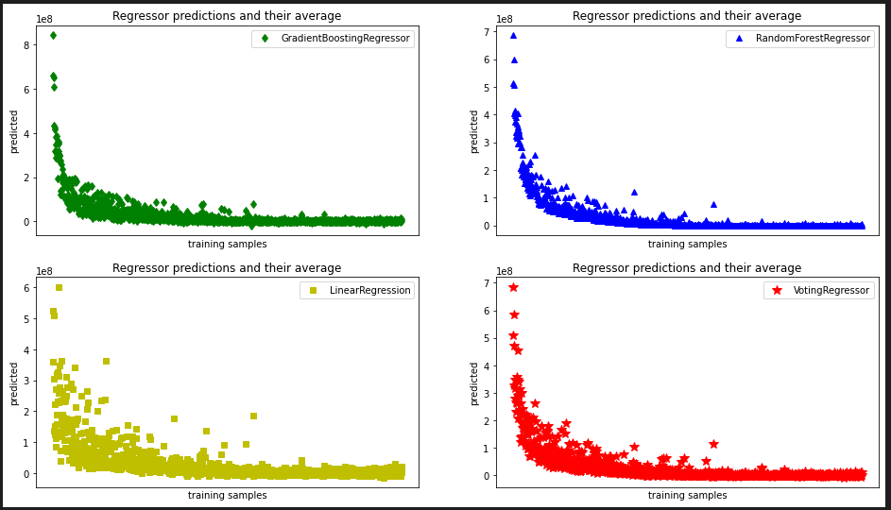
Regressor Predictions and their Average

Slide 12
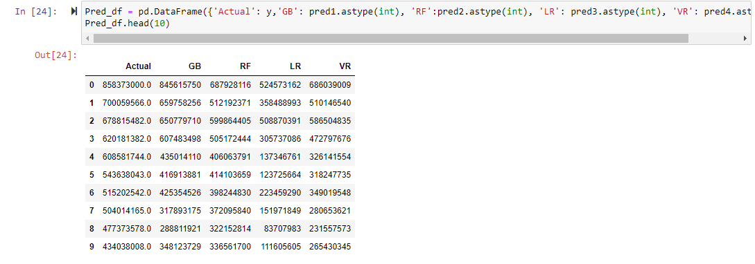
Predicted Gross for Each Model

Slide 13
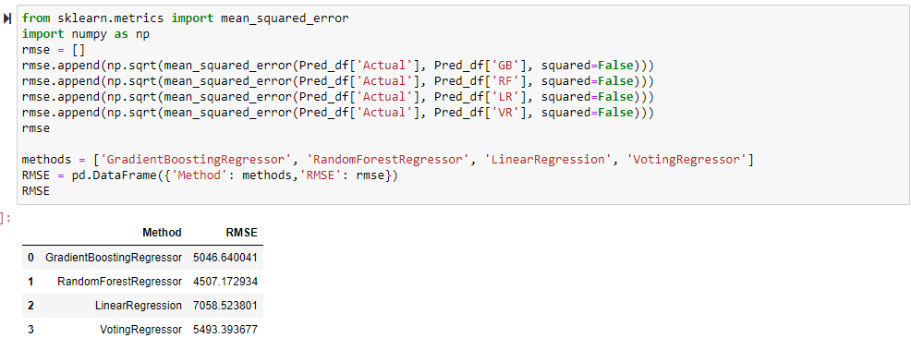
RMSE for Each Model

Slide 14
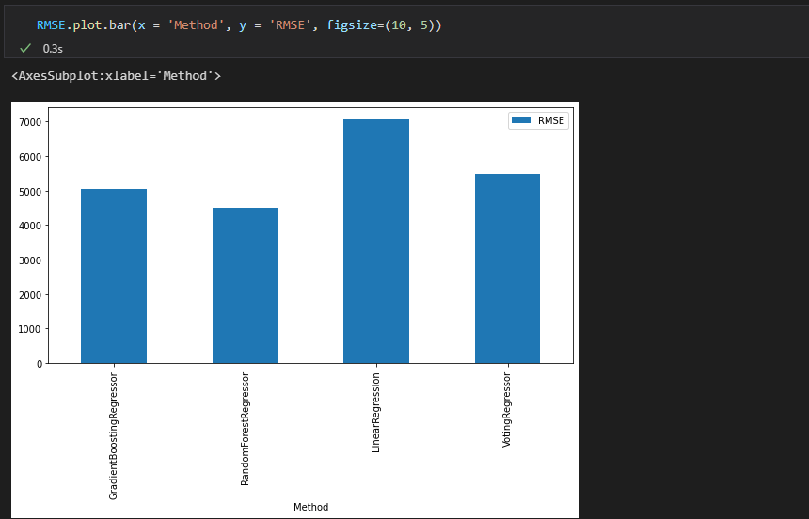
RMSE for Each Model
As we can see, the Random Forest Regressor gives the lowest RMSE. Hence, in this project we will use this regression model to predict the gross.

Slide 15
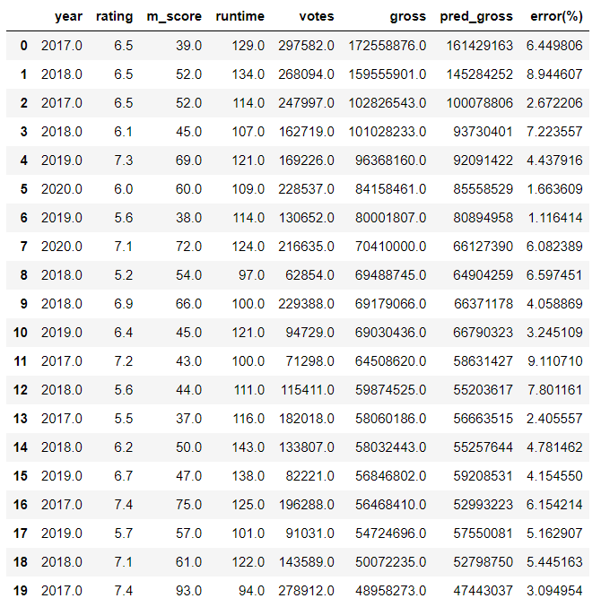
Research question
Can we predict a movie gross based on other features(rating, m_score, runtime, votes) using historical data?
Yes, we can predict the gross based other features and historical data using Random Forest Regressor which we used in this project, we can see that the model has less than 10% error rate on some results which is very high accuracy.

Slide 16
Summary
We have successfully answered the research question by crawling the relevant data about the question, cleaning it, exploring it and finally using Random Forest Regressor to get the prediction. We predicted the gross based other features and historical data.

